Slide 1
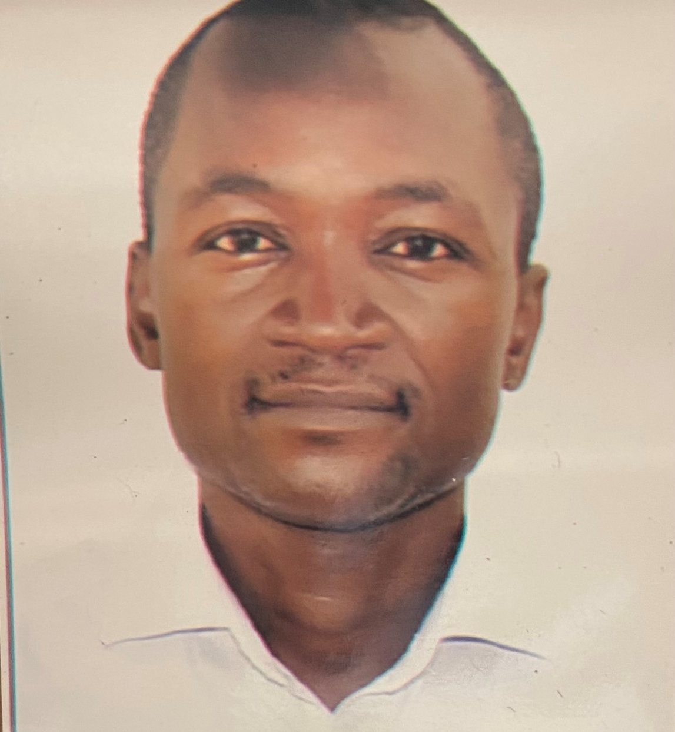
Dr. R.A. Lawal
Senior Lecturer
Department of Biochemistry
University of Lagos
+2348056036852
alawal@unilag.edu.ng

Slide 2
Lipid Metabolism

Slide 3
Overview
Fatty acids (F.A.s) are taken up by cells.
They may serve as:
  precursors in synthesis of other compounds
  fuels for energy production
  substrates for ketone body synthesis.
Ketone bodies may be exported to other tissues: used for energy production.
Some cells synthesize fatty acids for storage or export.

Slide 4
Energy
Fats are an important source of calories.
Typically 30-40% of calories in American diet are from fat.
Fat is the major form of energy storage.
Typical body fuel reserves are:
fat: 100,000 kcal.
protein: 25,000 kcal.
carbohydrate: 650 kcal.
Provides 60% of energy needs for body at rest
TAG reserves would enable someone to
survive starvation for ~30 days

Slide 5
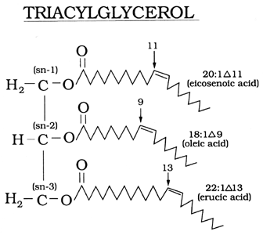
Digestion and Absorption of Lipids
98% of ingested lipids are
triacylglycerols (TAGs)
Digestion in the Mouth:
enzymes are aqueous
-little effect on lipids
Digestion in the Stomach:
causes a large physical
change:
-Churned into droplets:
“Chyme”

Slide 6
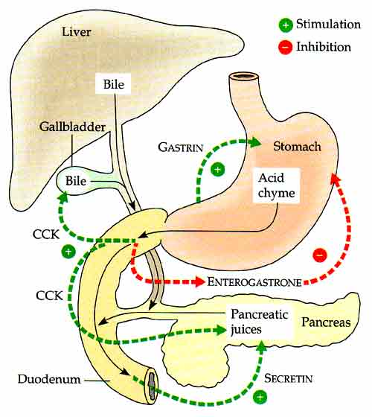
Gastric Lipase:
Begins actual
lipid digestion.
~10% of TAGs are hydrolyzed
in the stomach.
Chyme stimulates cholecystokinin (CCK) to release bile from gallbladder.
Bile is an emulsifier

Slide 7
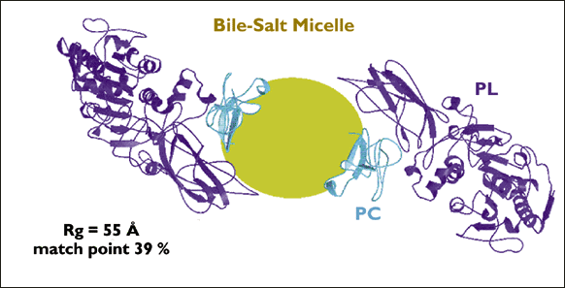
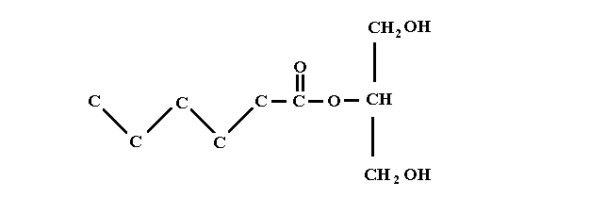
Pancreatic lipase (PL) hydrolyzes insoluble triglyceride by binding to the bile-salt micelles
TAGs are partially hydrolyzed: 2 of the 3 F.A.s have
ester linkages hydrolyzed and are released.
Monoacylglycerol remains = glycerol and 1 fatty acid

Slide 8
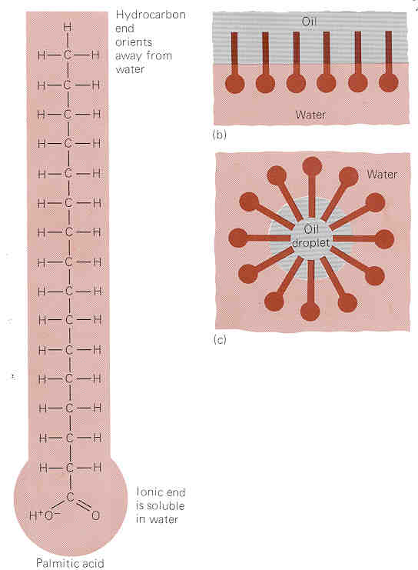
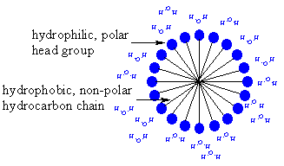
Oil droplets will form spherical micelle shapes.
Bile salts aid this process clumping fatty acids and monacylglycerols.

Slide 9
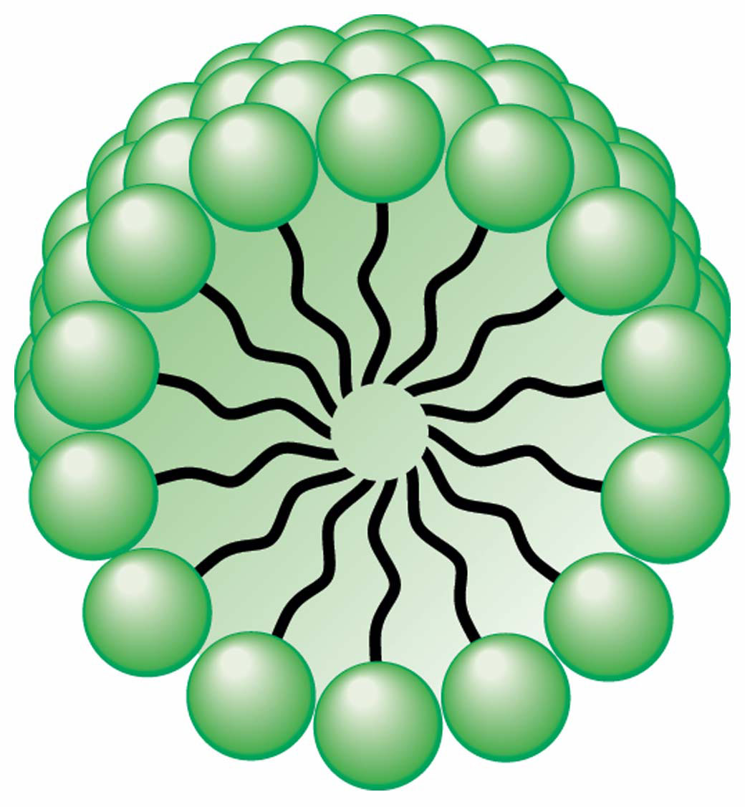
Fatty acid micelle: hydrophobic fatty acids & monoacylglycerols are in the interior.
Bile salts on exterior.
Micelles are small enough to penetrate membrane of intestinal cells.
Free fatty acids & monoacylglycerols are reformed into triacylglycerols.

Slide 10
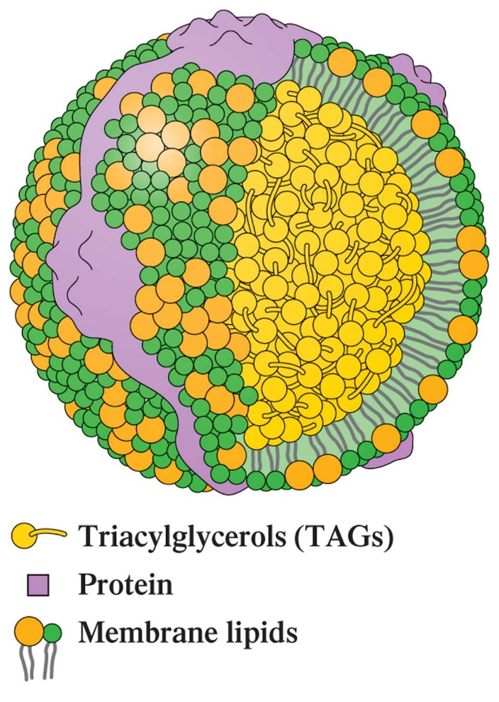
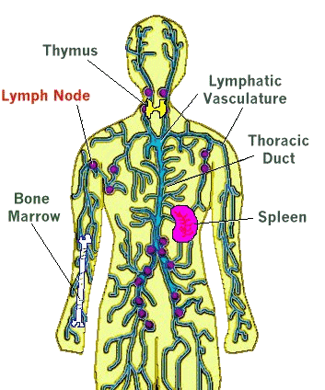
TAGs are combined with membrane & water soluble proteins to form a chylomicron, a lipoprotein.
Chylomicrons carry TAGs from intestinal cells into bloodstream
via the lymph system.

Slide 11
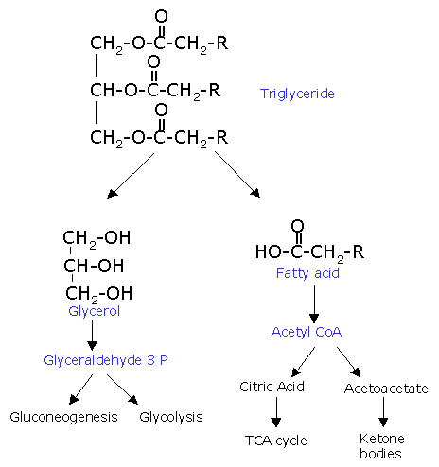
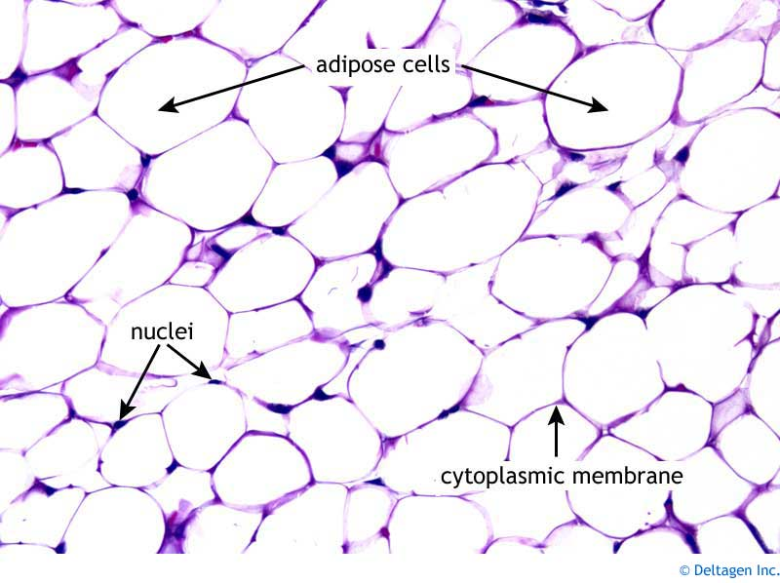
Triacylglycerols reach bloodstream
& are hydrolyzed down to glycerol and fatty acids.
These are absorbed by cells and
processed further for energy by forming acetyl CoA.
or
Stored as lipids in fat cells (adipose tissue)

Slide 12
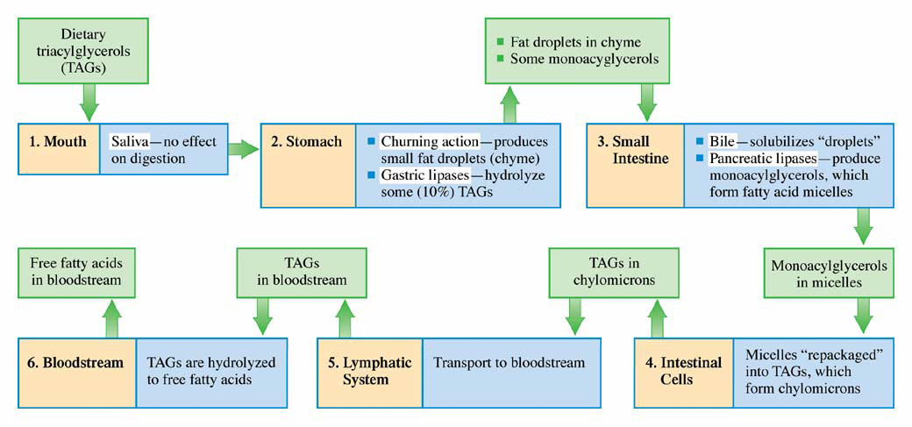
Summary of events that must occur before triacyglycerols (TAGs) can reach the bloodstream through the digestive process.

Slide 13
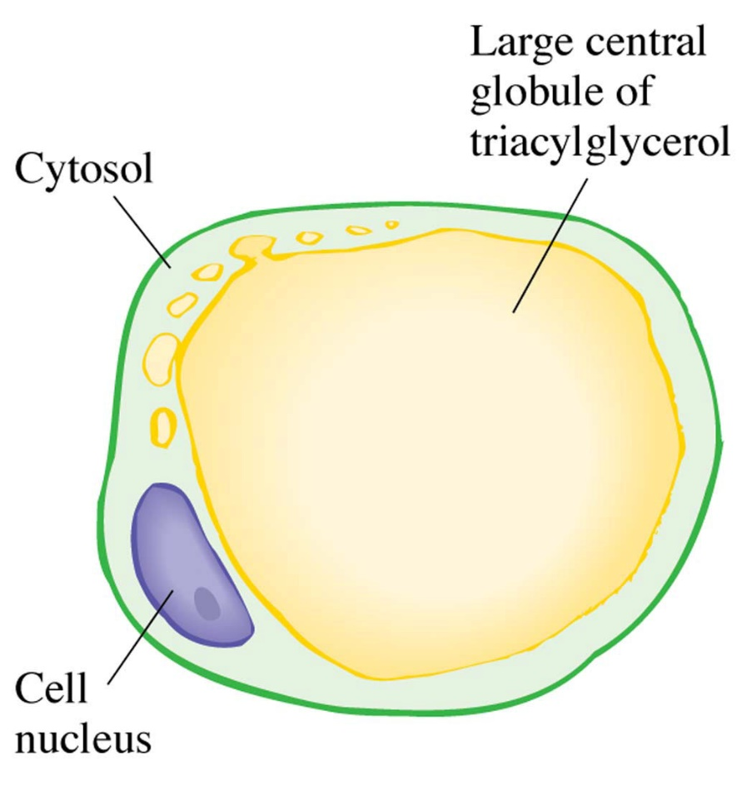
Triglyceride Storage & Mobilization
Storage of triacylglycerol is in adipocytes
Fatty acids stored primarily as triacylglycerol.
Triacylglycerol
is hydrolyzed
to release
fatty acids
when needed.

Slide 14
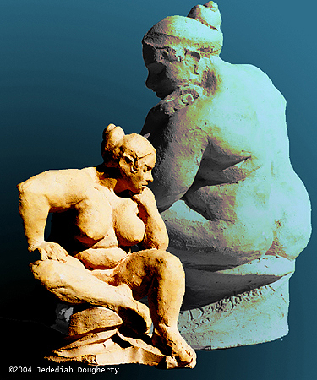
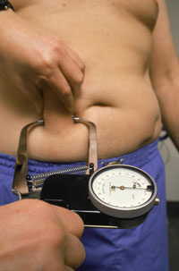
Adipocytes are found mostly in the abdominal cavity and subcutaneous tissue.
Store energy, insulation against heat loss,
shock absorber for organs.
Adipocytes are metabolically very active:
triacylglycerol constantly hydrolyzed & re-synthesized.

Slide 15
Hormonal control of lipolysis
The breakdown of triglycerides by lipases
is under hormonal control.
Hormones involved are:
Epinephrine, glucagon, and insulin.
Epinephrine & glucagon:
promote breakdown of fat (lipolysis)
Insulin:
inhibits lipolysis.

Slide 16
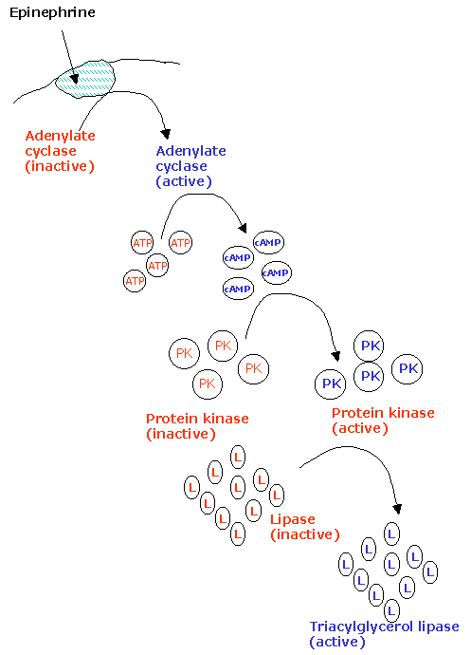
Triacylglycerol Mobilization:
Hydrolyzing lipid reserves
in adipose tissue
for energy
Triggered by hormones
~10% TAGs replaced in adipose tissue daily
as they get used up
for energy

Slide 17
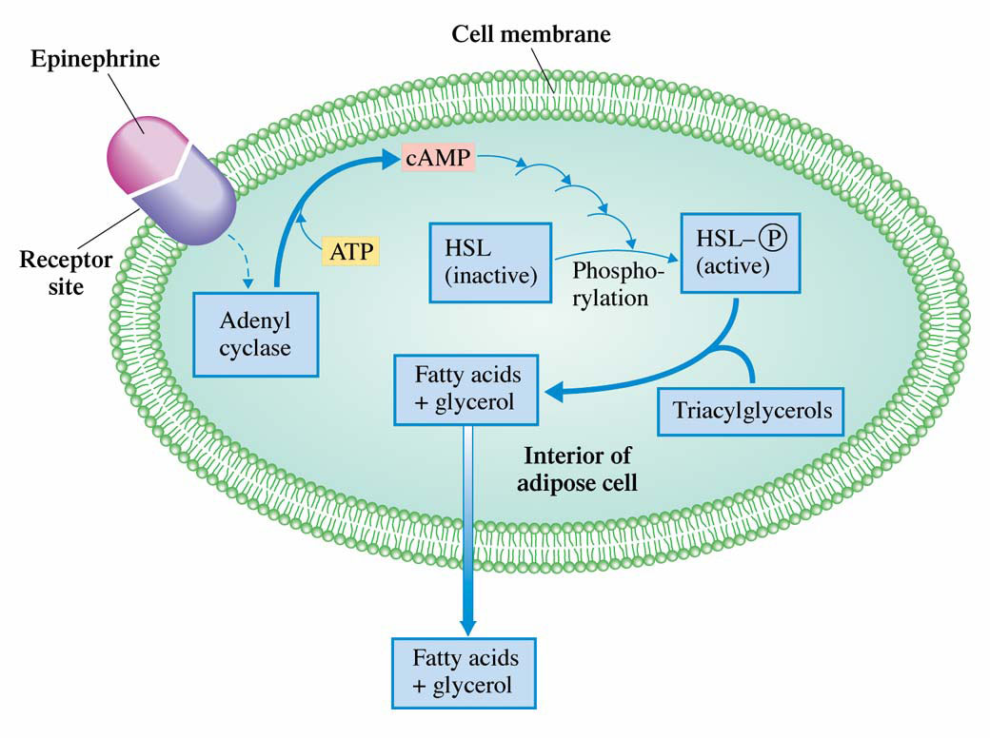
Hydrolysis of stored triacylglycerols in adipose tissue is triggered by hormones that stimulate cAMP production within adipose cells.

Slide 18
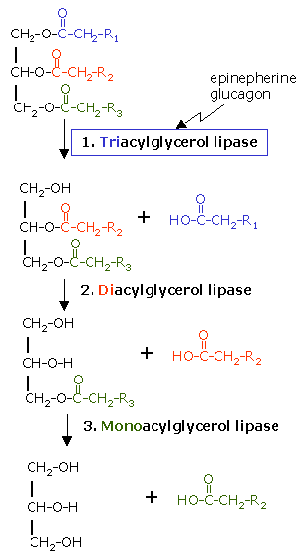
Third time is a charm!
TAGs hydrolyzed
a 3rd time
to form fatty acids.
Triacylglycerol lipase
Diacyclglycerol lipase
Monoacylglycerol lipase
Only triacylglycerol lipase is activated by epinephrine.

Slide 19
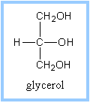
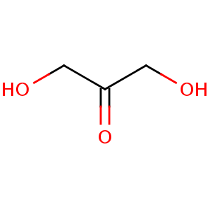
Glycerol Metabolism
One glycerol formed for each TAG hydrolyzed.
Enter bloodstream & go to liver or kidneys for processing.
Converted in 2 steps to Dihydroxyacetone phosphate

Slide 20
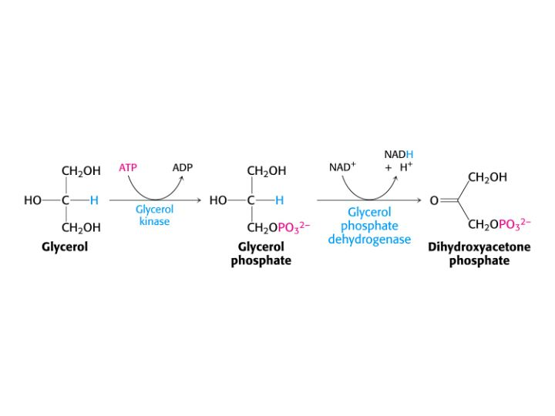
Uses up one ATP
Reduces one NAD⁺ to NADH
Primary hydroxyl group is phosphorylated
Oxidized to form a Ketone

Slide 21
Dihydroxyacetone phosphate
is an intermediate for both
Glycolysis:
converted to Pyruvate, then to Acetyl CoA, & eventually to CO₂, releasing its energy.
Gluconeogenesis:
creates Glucose from non-carbohydrate source
Lipid metabolism & carbohydrate metabolism
are connected.

Slide 22
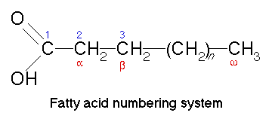
Fatty acids can also be
broken down for energy.
What kind of reaction is needed?
Oxidation!
Quick review first on fatty acid numbers & letters:

Slide 23
Review Important fatty acids:
Name | # Carbons: (saturation)
Palmitate | 16:0
Stearate | 18:0
Palmitoleate | 16:1 - cis at C9
Oleate | 18:1 - cis at C9
Linoleate | 18:2 - cis at C9 and C12
Linolenate | 18:3 - cis at C9, C12 & C15

